Slide 1
CIS 525 – Introduction to Networking Final Exam Review: Everything from the Exam I and II review slides, plus the following…
Eugene Vasserman

Slide 2
Available Bandwidth
Knee load: critical bandwidth when latency increases significantly
Wanted to keep the load around the knee
Assume that timeout mechanism provides feedback about reaching the knee load

Slide 3
AIMD with Congestion Avoidance
congestion
avoidance
additive
increase

Slide 4
TCP Packet Pacing
Congestion window helps to “pace” the transmission of data packets
In steady state, a packet is sent when an ACK is received
Data transmission remains smooth, once it is smooth
Self-clocking behavior
P_{b}
P_{r}
Sender
Receiver
A_{s}
A_{r}
A_{b}

Slide 5
Silly Window Syndrome
Interaction:
After the receiving application reads an octet from a full buffer, one octet of space is available
Then, TCP generates an ACK to advertise an “available” window size of 1 octet
The sending TCP implementation composes a segment containing 1 octet of data
This interaction (called the Silly Window Syndrome) results in a steady state in which TCP sends a separate segment for each octet of data
Each ACK advertises a small amount of space available, and each segment carries a small amount of data

Slide 6
Avoiding Silly Window Syndrome
Reciever-Side Avoidance:
Before sending an advertisement after advertising a zero window, wait for space to become available that is 50% of the total buffer size or equal to a maximum sized segment
Sender-Side Avoidance (Nagle’s Algorithm):
When previous data has not been acknowledged, do not send additional data until a maximum-sized segment is full
When an ACK arrives, send all data that has accumulated, even if the segment is not full

Slide 7
Slow Start Packet Pacing
How do we get this clocking behavior to start?
Initialize cwnd = 1 (one MSS)
Upon receipt of every ACK, cwnd = cwnd + 1
Implications
Window actually increases to W in RTT * log₂(W)
Can overshoot window and cause packet loss

Slide 8
Return to Slow Start
If packet is lost, we lose our self-clocking as well
Need to implement slow-start and congestion avoidance together
When timeout occurs set ssthresh to W/2
If cwnd < ssthresh, use slow start
Else use congestion avoidance

Slide 9
Fast Retransmit
What are duplicate ACKs (dupACKs)?
Repeated ACKs for the same sequence
When can duplicate ACKs occur?
Loss
Packet re-ordering
Window update – advertisement of new flow control window
Assume re-ordering is infrequent and not of large magnitude
Use receipt of 3 or more duplicate ACKs as indication of loss
Don’t wait for timeout to retransmit packet

Slide 10
Delayed ACKS
Problem:
In request/response programs, you send separate ACK and Data packets for each transaction
Solution:
Don’t ACK data immediately
Wait 200ms
Must ACK at least every other packet – why?
Must not delay duplicate ACKs – why?
Notes:
Wait must be less than 500ms – why?

Slide 11
Delayed ACK Impact
TCP congestion control triggered by ACKs
If receive half as many ACKs → window grows half as fast
Slow start with window = 1
Will trigger delayed ACK timer
First exchange will take at least 200ms
Start with > 1 initial window
Bug in BSD, now a “feature”/standard

Slide 12
Round Trip Time Estimation
Wait at least one RTT before retransmitting
Importance of accurate RTT estimators:
Low RTT estimate
Unnecessary retransmissions
High RTT estimate
Poor throughput
RTT estimator must adapt to change in RTT
But not too fast, or too slow!
“Conservation of packets” principle – never more than a window worth of packets in flight

Slide 13
Timestamp Extension
Used to improve timeout mechanism by more accurate measurement of RTT
When sending a packet, insert current timestamp into option
4 bytes for timestamp, 4 bytes for echo
Receiver echoes timestamp in ACK
Actually will echo whatever is in timestamp
Removes retransmission ambiguity
Can get RTT sample on any packet

Slide 14
Sliding Window Revisited
Sending Side
Receiving Side
LastByteAcked <= LastByteSent
LastByteSent <= LastByteWritten
Buffer bytes between LastByteAcked and LastByteWritten
LastByteRead < NextByteExpected
NextByteExpected <= LastByteRcvd +1
Buffer bytes between NextByteRead and LastByteRcvd
Sending application
Receiving application
TCP
TCP
LastByteWritten
LastByteRead
LastByteAcked
LastByteSent
NextByteExpected
LastByteRcvd

Slide 15
TCP Sawtooth Behavior
Congestion
Window
Timeouts
may still
occur
Slowstart
to pace
packets
Time
Initial
Slow start
Fast
Retransmit
and Recovery

Slide 16
Session Layer
“Value-added” services built on top of transport layer
Rollback / recovery
Remote procedure calls (RPC)
Three phases:
Establishment
Use
Release
Presentation Layer Protocols
ASN.1

Slide 17
Rollback / Recovery
Checkpoints can be used to mark known consistent states
When a failure occurs, the session can be rolled back to the previous checkpoint
Example: advanced file transfer protocols use rollback recovery

Slide 18
Presentation Layer
Preserves meaning of transmitted information
See how this fits in with RPC?
Three major issues:
Representation
Compression
Encryption (Chapter 8)

Slide 19
Box Notation vs. Type-Length-Value
Box notation
Intuitive way of describing a data format
Field types/encoding specified separately
Limitations: no variable-length fields
Type-Length-Value (TLV), or tabular/tuple
Representation of variable-size or optional message fields
Can be parsed without understanding the meaning of the field

Slide 20
ASCII Box Notation for TCP Header [RFC 793]

Slide 21
Example: TCP Header Options

Slide 22
Canonical Intermediate Forms
Tabular and Box format
Type-Length-Value (TLV)
Example: ASN.1 – Abstract Syntax Notation One
Tagged message type: <type, length, value>
Support compound (seq) types:
<type(seq),length,type,length,value,type,length,value>
Fixed format
Example: XDR – eXternal Data Representation
Defines standard format for basic data types
Untagged – must define XDR stream, and encode or decode
See Ex17.c

Slide 23
Encoding
ASN.1 doesn’t determine transfer syntax
Standardized encoding rules:
Basic encoding rules (BER) [X.690]
Canonical and Distinguished encoding rules (CER, DER)
Packed encoding rules (PER) [X.691]
XML encoding rules (XER) [X.693]
Specification of specialized encoding rules: Encoding control notation (ECN) [X.692]

Slide 24
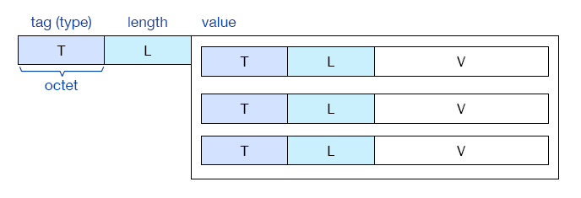
Basic Encoding Rules (BER)
Rules for encoding abstract into concrete data
Encoding in TLV style (tag-length-value)
TLVs can be nested, i.e. the value can contain a sequence of TLVs

Slide 25
BER vs. Other Encoding Rules
Shortcomings of BER:
Lengthy: type and length fields are always octets, e.g. a boolean value requires 3 octets (24 bits)
Encoding rules with some degrees of freedom (e.g. different ways of cascading TLVs)
CER/DER (Canonical and Distinguished Encoding Rules)
Restrictions on BER: only one possible encoding (injectivity; used in security protocols, e.g. exchange of certificates)
PER (Packed Encoding Rules)
Size reduction by giving up the TLV format

Slide 26
Packed Encoding Rules
PER format: [P][L][V] instead of TLV:
Optional preamble,
Optional length,
Optional value
Series of bits instead of octets
Tags are not encoded
Preambles are used for choices
Length is only encoded when necessary (e.g. no type size limitation by the ASN.1 specification)
Optional components of a sequence or set is indicated in a bitmap preceding the value encoding

Slide 27
BER vs. PER Example: BER

Slide 28
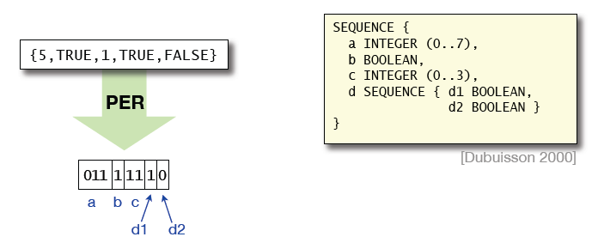
BER vs. PER Example: PER
PER can reduce the overall length of the encoding, but it’s not as extensible
101 1 01 1 0

Slide 29
XML Encoding Rules (XER)
Delimit ASN.1 values with XML markups

Slide 30
Simple Network Management Protocol (SNMP)
UDP/IP network management protocol
Defines communication between manager and agent
Message formats
Interpretation of messages
Data representation (using ASN.1)

Slide 31
Fetch-Store Paradigm
Manager-agent interaction based on fetch-store paradigm and trap paradigm
Fetch retrieves a value from the agent
Store changes a value on the agent
Trap send a value from agent to manager
Fetch: monitor internal data values and data structures
Store: modify and control data values and data structures; also control behavior
Trap: report alarm conditions

Slide 32
SNMP Operations
Get (fetch) retrieves value of object
Set (store) stores new values into object
Get-next retrieves next object (for scanning, or “walking”)
Trap for agent to send alarm to manager

Slide 33
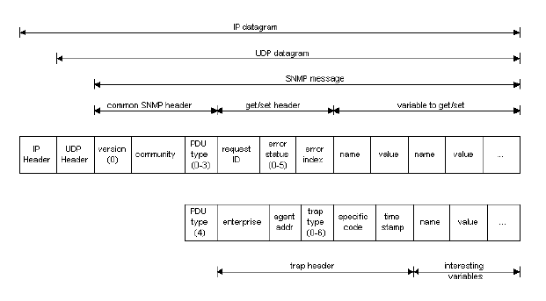
SNMP Message Format

Slide 34
SNMP Example “Decoded”
viper% snmpget -v1 -d -c public 129.130.10.39 ip.ipInReceives.0
30 29 02 01 00 04 06 70 75 62 6C 69 63 A0 1C 02
04 2C 79 D1 3C 02 01 00 02 01 00 30 0E 30 0C 06
08 2B 06 01 02 01 04 03 00 05 00
30 29 = sequence of 41 bytes
02 01 00 = version (00 + 1) = version 1
04 06 70 75 62 6C 69 63 = community string (“public”)
A0 1C = PDU type = “GET”, total request length 28 bytes
02 04 2C 79 D1 3C = REQUEST ID
02 01 00 = ERROR STATUS
02 01 00 = ERROR INDEX
30 0E = sequence of length 14 bytes containing request
30 0C = sequence of length 12 bytes containing OID
06 08 2B 06 01 02 01 04 03 00 = 1.3.6.1.2.1.4.3.0
05 00 = NULL String of length 0 (END OF STRING)

Slide 35
Domain Name System (DNS)
Translates human-readable domain names to IP addresses
“Simple” query-response over UDP
Compare to Address Resolution Protocol (ARP)
Security concerns (poisoning, etc.)
DNSSEC
Partial/temporary fixes
May someday replace certificate infrastructure (HTTPS (TLS))

Slide 36
Security Basics
“Secure against what?”
Threat/attacker model, players and resources
The only thing secret about a secure system should be the “secret key”
–Kerckhoffs’ principle
“The enemy knows the system”
–Shannon’s maxim
Notes:
No security through obscurity, although perhaps security through obfuscation
Secure hardware
From “Satan’s computer”: “a computer which gives answers which are subtly and maliciously wrong at the most inconvenient possible moment” – safety vs. security

Slide 37

Safety vs. Security
Think like an adversary!
Random → malicious faults
Engineering for security:
“What’s the worst that can happen?”
Assume it will…
Always, always, ALWAYS state your assumptions!

Slide 38
Tools: Encryption
Basic idea: someone seeing ciphertext learns nothing about plaintext without correct key
With or without authentication
Symmetric – based on tests/best guess
e.g. AES (block cipher)
Asymmetric – based on math assumptions
e.g. RSA
Notes:
Start with substitution cipher… Why not?
Difference in assumptions/security between symmetric and asymmetric
Symmetric is ~10x faster

Slide 39
Authenticity and Integrity
Basic ideas:
Authenticity: the message was produced by a specific known subject
Authentication ≠ integrity
Integrity: the message has not been altered between source and destination
Messages without integrity protection vulnerable to chosen ciphertext attack
Notes:
Why do we need e.g. integrity when encrypting?
What doesn’t this say? Time? One-time [unconditional] authentication codes

Slide 40




Key Agreement: Person-in-the-middle
Alice
?
Bob
Bob
Alice
Private
NOT Authenticated

Slide 41
Key Agreement: Person-in-the-middle
Alice?
Bob
Muahaha!
Bob
Alice
NOT Private
NOT Authenticated

Slide 42
Tools: Authentication
Symmetric (shared key)
Asymmetric
Trusted third party vs. trust-on-first-use
TLS (was SSL) and SSH
Why is asymmetric crypto authenticated now, but not a moment ago?
Symmetric is deniable
SSH, TLS, VPN – which is asymmetric?
Notes:
Authentication provides what? Authenticity, integrity (signatures).
Any MAC; RSA, DSA
Replay attacks!

Slide 43
Certificates (TLS)
Alice!
Bob
CRAP!
Bob
Alice
Private
Authenticated

Slide 44
TLS (was SSL/TLS)
How do we know a website is “genuine”?
We trust a third party
Not:
“This is mybank.com”
More like:
“Trusted third party says ‘This is mybank.com’”
What if we swap “trusted” parties?
Trusted vs. trustworthy

Slide 45
Chain of Trust
User A says:
I want access to resource R
Kerberos server, authenticate me!
R does not know if A has rights to access R
Kerberos server:
Checks if A is who she says she is
Checks if A is authorized for access to R
R trusts Kerberos server but not A

Slide 46
Final Exam
Final exam on Tuesday December 11th at 4:10 pm
(same room as class)

